Slide 1
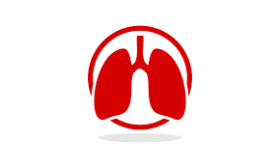
Interstitial Pulmonary Diseases
University of Basrah AlZahraa Medical College
Respiratory System Module Academic Year 2022-2023 (2^{ed} Year)
Session 10 Lecture 1
Dr. Nehaya Mnahi [Module leader]
Dr. Hadeel Salman [Module co-leader]
Dr. Ahmed Bader
Dr. Ahmed Dawii
Dr. Nawal Mustafa
Dr. Ameer Qassim
Dr. Zuhair Abdul Kareem
Dr. Mustafa Emad

Slide 2
Learning Objectives
By the end of the lecture you should know
The definition of diffuse parenchymal lung disease
Symptoms in common for diffuse parenchymal lung disease
Characteristics of Idiopathic Pulmonary Fibrosis (IPF)
Characteristics of Non-Specific Interstital Pneumonia (NSIP)
The approaches to these conditions

Slide 3
Diffuse Parenchymal Lung Disease
Heterogeneous group of conditions affecting the pulmonary parenchyma (interstitium) and/or alveolar lumen
Share a sufficient number of clinical, physiological and radiographic similarities
Notes:
Considered collectively
The lung involvement in these disorders is often diffuse but can occur in a wide array of patterns. The disease process can involve any part of the anatomic lung interstitium, including that within the alveolar walls, the intra- and interlobular septa, and the airways. However, it can also involve the air spaces and airway lumens themselves, and therefore the term interstitial lung disease is somewhat misleading. Diffuse parenchymal lung disease (DPLD) is the more accurate name for this collection of disorders

Slide 4
Over 100 distinct ILDs have been described
Exposure-related ILDs
ILDs attributable to systemic diseases
Idiopathic ILDs
Generally considered in one of three broad categories
No universally accepted classification system

Slide 5
Features common to the diffuse parenchymal lung diseases
Clinical Presentation
Cough: Dry, persistent and distressing
Breathlessness: insidious onset & slowly progressive
Examination
Crackles: bilateral and basal
Clubbing
Central cyanosis and signs of right heart failure (Advanced)
Notes:
Well over 100 distinct ILDs have been described, and there is no universally accepted classification system. One useful way of approaching ILDs is to consider them as all belonging to one of three broad categories: (1) exposure-related ILDs, (2) ILDs attributable to systemic diseases, and (3) idiopathic ILDs

Slide 6
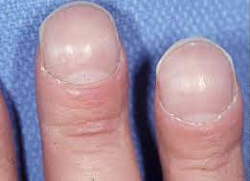
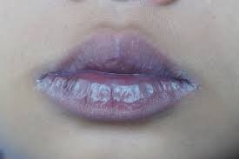

Slide 7
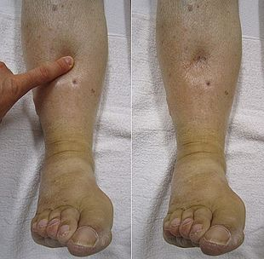

Slide 8
Radiology
Chest X-ray
High-resolution computed tomography (HRCT)
Ground glass changes
Reticulonodular shadowing
Honeycomb cysts and traction bronchiectasis
Small lung volumes with reticulonodular shadowing
Normal in early or limited disease
Notes:
depending on stage of disease

Slide 9
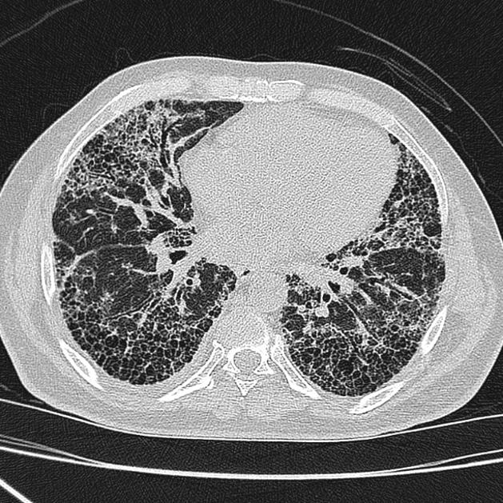
X- ray show reticular opacities (UIP)
Axial HRCT basal and peripheral reticular opacities with honeycombing and traction bronchiectasis

Slide 10
Pulmonary Function
Restrictive ventilatory defect
Reduced lung volumes
Impaired gas transfer
Exercise tests (exercise-related fall in SaO2)

Slide 11
Idiopathic Pulmonary Fibrosis (IPF)
Progressive fibrosing interstitial pneumonia
Occur in adults
Histological or radiological pattern of UIP
Unknown cause

Slide 12
The histological features are suggestive of repeated episodes of focal damage to the alveolar epithelium
Speculated etiology include
Exposure to viruses (e.g. Epstein–Barr virus)
Occupational dusts (Metal or Wood)
Drugs (Amiodarone, Bleomycin, Cyclophosphamide, MTX, Sulfonamides, etc.)
Chronic gastro-oesophageal reflux
Familial cases are rare (Genetic Factors)
Strong association with cigarette smoking

Slide 13
Clinical Features
Uncommon before the age of 50 years
May present as an incidental finding in an asymptomatic individual
Constitutional symptoms are unusual
Finger clubbing and Bi-basal fine late inspiratory crackles
Typically presents with insidious progressive dyspnea & non-productive cough

Slide 14
Investigations
1.Chest X-ray
Bilateral lower lobe and sub pleural reticular shadowing
Normal in individuals with early or limited disease

Slide 15
2.HRCT typically demonstrates
Patchy, peripheral, sub pleural and basal reticular pattern
Honeycombing cysts and traction bronchiectasis (More advanced disease)
HRCT appearances sufficiently distinctive to suggest an alternative diagnosis such as
Hypersensitivity Pneumonitis
Sarcoidosis
Asbestosis (Pleural plaques )
HRCT has a high positive predictive value for the diagnosis of IPF so the biopsy seldom necessary

Slide 16
3.Pulmonary Function Tests
Restrictive defect
Reduced lung volumes
Reduced Gas transfer
Dynamic tests demonstrate
Arterial hypoxaemia and hypocapnia are present even at rest (Advances Stages)
Exercise-induced arterial hypoxaemia
Notes:
However, lung volumes may be preserved in patients with concomitant emphysema

Slide 17
4.Bronchoscopy is seldom indicated unless there is serious consideration of differential diagnoses
Infection
Malignancy
Chronic hypersensitivity pneumonitis (Lymphocytosis)
5.The tissue samples obtained by trans bronchial lung biopsy are insufficient to be of value, and if tissue is required, a surgical lung biopsy should be sought

Slide 18
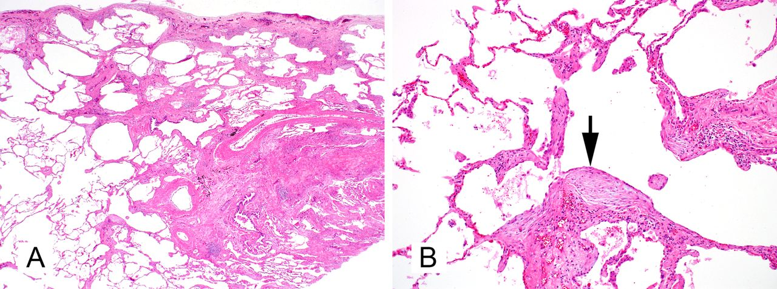
Characteristics of the UIP (Histological pattern predominantly encountered in IPF)
(A) Large confluent zones of pulmonary fibrosis (at the pleural surface and lower right) alternate with areas of uninvolved parenchyma (lower left)
(B) At higher resolution, immature fibrosis in the form of fibroblast foci is identified which illuminate the active fibrosing process (arrow)

Slide 19
It is not uncommon to identify a mildly positive ANA or anti-CCP2
Lung disease may precede the appearance of CTD

Slide 20
Management
If the VC between 50% and 80% predicted, Patients offered either Pirfenidone (anti fibrotic agent) or Nintedanib (tyrosine kinase inhibitor)
Pirfenidone cause Photosensitivity
Nintedanib cause Diarrhoea
Neither drug improves cough or breathing difficulty
Both of them Reduce the rate of decline in lung function
Treatment should be discontinued if lung function declines by more than 10% over the first year of treatment
Avoid direct exposure to sunlight
Use photo protective clothing & Sun screens

Slide 21
PPI to control GORD
May improve the cough
Advised to stop Smokers
Increased risk of lung cancer
Influenza and pneumococcal vaccination
Encouraged to exercise
Domiciliary oxygen
Palliation in severe cases
Lung transplantation
Join in pulmonary rehabilitation using ambulatory oxygen

Slide 22
Treatment of Acute IPF Exacerbations
The optimum treatment for acute exacerbations is un known
Treatment (supportive) *
Broad-spectrum antibiotics
Glucocorticoids
Occasionally immunosuppression
* Few data to support this approach

Slide 23
Prognosis
The natural history is usually one of steady decline
A median survival of 3 years
The Finding of high numbers of fibroblastic foci on biopsy suggests a more rapid deterioration
Serial lung function testing may provide useful prognostic information
Notes:
The natural history is usually one of steady decline; however, some patients are prone to exacerbations accompanied by an acute deterioration in breathlessness, disturbed gas exchange, and new ground glass changes or consolidation on HRCT.
But progression varies considerably from death within a few months to survival with minimal symptoms for many years

Slide 24
Essential Points to Remember
Insidious onset of progressive dyspnea and nonproductive chronic cough
Bibasilar dry rales; digital clubbing and right heart failure with advanced disease
Chest radiographs with low lung volumes and patchy distribution of ground glass, reticular, nodular, reticulo-nodular, or cystic opacities
Reduced lung volumes, pulmonary diffusing capacity, and 6-minute walk distance; hypoxemia with exercise

Slide 25
Non-Specific Interstitial Pneumonia (NSIP)
NSIP is similar to IPF but Patients tend to be women & younger in age
Etiology
Idiopathic
Connective tissue disease ( Lung Disease may precede the appearance of CTD)
Drugs
Chronic hypersensitivity pneumonitis
HIV infection
HRCT findings are less specific than with IPF (Lung biopsy may be required)
The prognosis is significantly better than that of IPF (The 5-year mortality rate is less than 15% )

Slide 26
Sarcoidosis
Multisystem disorder of unknown aetiology (90% involve the lungs )
Characterised by the presence of non- caseating granulomas
Lofgren's Syndrome (30%)
Erythema nodosum
Peripheral arthropathy (Mostly Ankles)
Uveitis
Bilateral hilar lymphadenopathy (BHL)
Treatment with NSAIDs and rarely with short course of steroids
Acute illness often seen in young women and characterised by

Slide 27
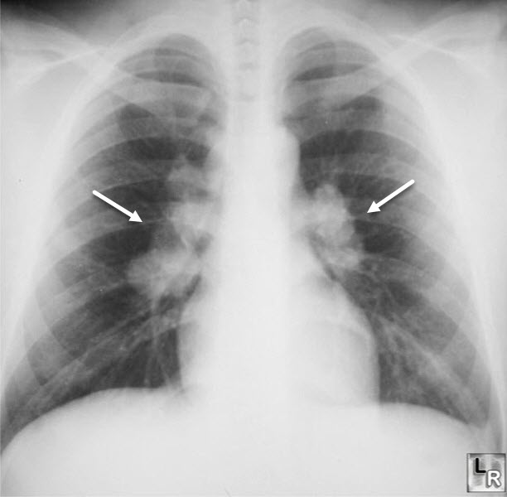
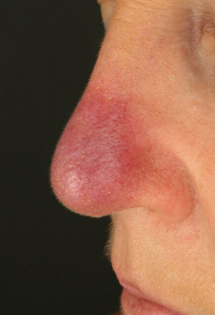
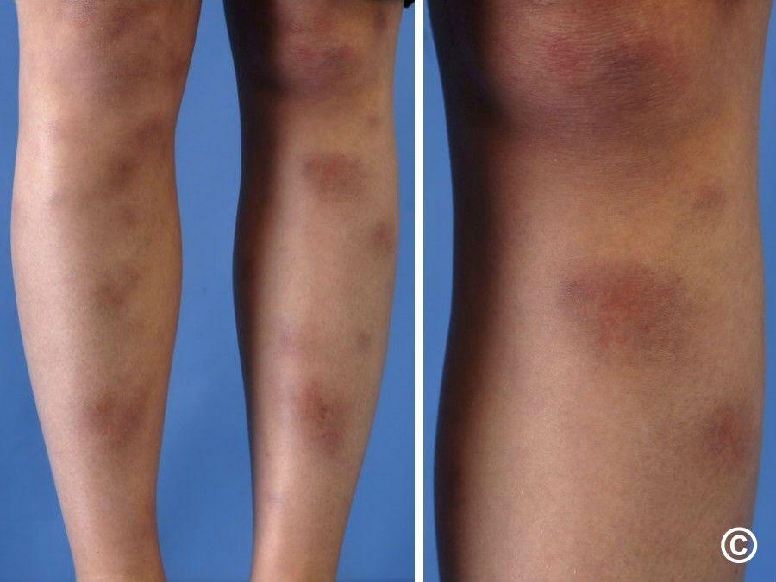
Nasal cutaneous sarcoid lesions (Lupus Pernio )
Erythema nodosum
Bilateral Hilar Lymphadenopathy
Non-caseating granuloma from mediastinal lymph node biopsy confirming sarcoidosis

Slide 28
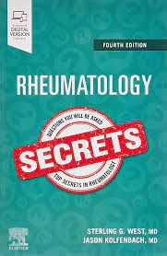
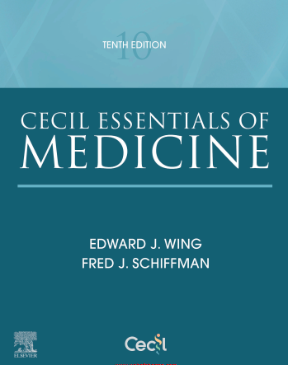
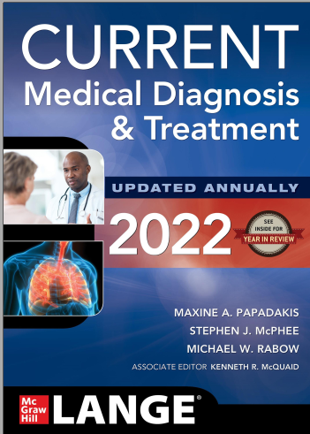
References
Davidson’s Principles and practice of medicine 23rd edition
Rheumatology Secrets 4th edition
Cecil essential of Medicine tenth edition
Current Medical diagnosis and treatment 2022
British Medical journal

